Slide 1
Cyber security
-bootcamp

Slide 2

It is the way of Providing protocols and methods in order to protect our systems from information tampering, software and hardware damage and misuse of services
What is Cyber Security?

Slide 3


Cyber Security Jobs in India
Network Security Engineer [4-8LPA]
Cyber Security Analyst [6LPA+]
Security Architect [12-19LPA+]
Cyber Security Manager [18-23lpa+]
Chief Information Security Officer (CISO) [36LPA-1cr+]

Slide 4
NETWORKING PROTOCOLS
A NETWORK PROTOCOL IS A SET OF PREDEFINED RULES THAT AID IN PROPER TRANSMISSION OF data between endpoints
COMMONLY USED PROTOCOLS:
TCP/IP – Transmission Control Protocol
UDP – User Datagram Protocol
FTP – File Transfer Protocol
SMTP – Simple Mail Transfer Protocol

Slide 5
packets
Chunks of information is broken down into basic units called packets. It contains control information and transmission data
PAYLOAD
PAYLOAD IS A PIECE OF CODE THAT IS USED TO EXPLOIT A VULNERABILITY AND THERBY INJECTING MALICIOUS CONTENT INTO A SYSTEM

Slide 6
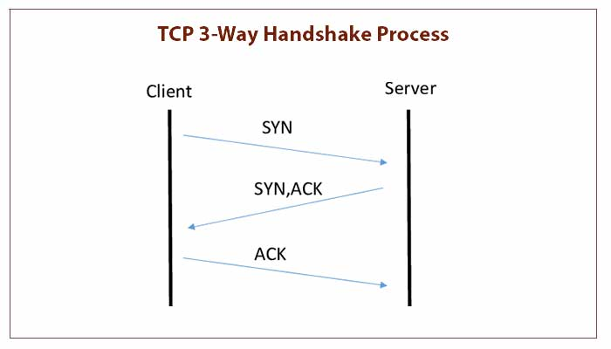
3 Way Handshake – TCP/IP
.

Slide 7
Port:
a port Is a Virtual communication Endpoint
Port Numbers: [0-65536]
FTP – 21
SSH – 22
SMB – 445
SMTP – 25
DNS – 53
HTTP – 80
HTTPS - 443

Slide 8
GENERAL TERMS
EVENt
INCIDENt
ALERT
change in the normal behavior of system
Ex: someone logs into their account
change in a system that negatively impacts the organization
EX: An employee replies to a phishing email, divulging confidential information
An alert is a notification of a cybersecurity event
Ex: send an alert to admin if more than 5 unsuccessful login attempts were made

Slide 9
PENETRATION TESTING
A penetration test, also known as a pen test or ethical hacking, is an authorized simulated cyberattack on a computer system, performed to evaluate the security of the system

Slide 10
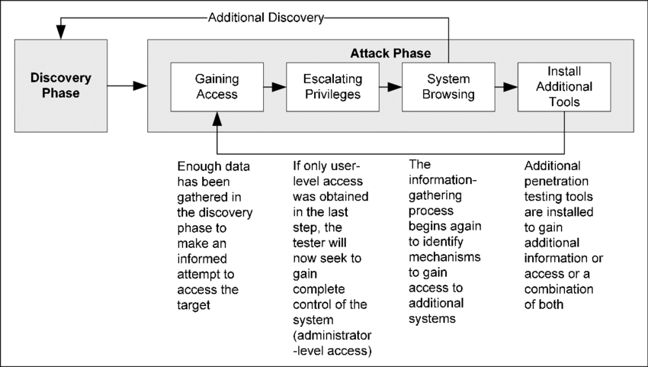
Attack phase
.

Slide 11
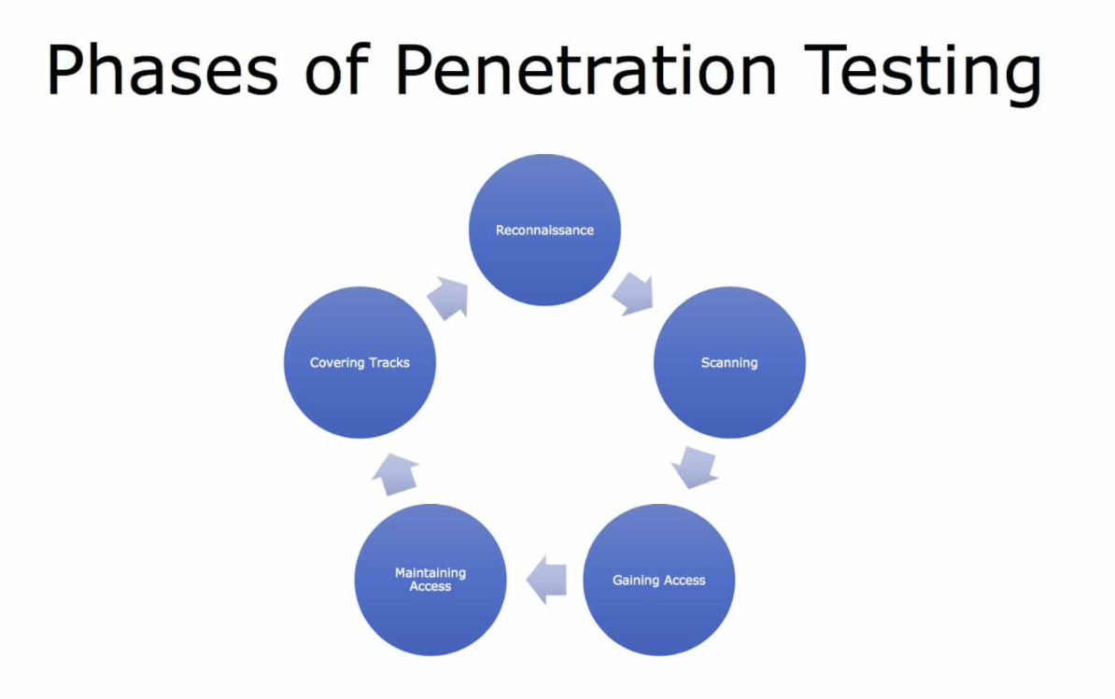
.

Slide 12
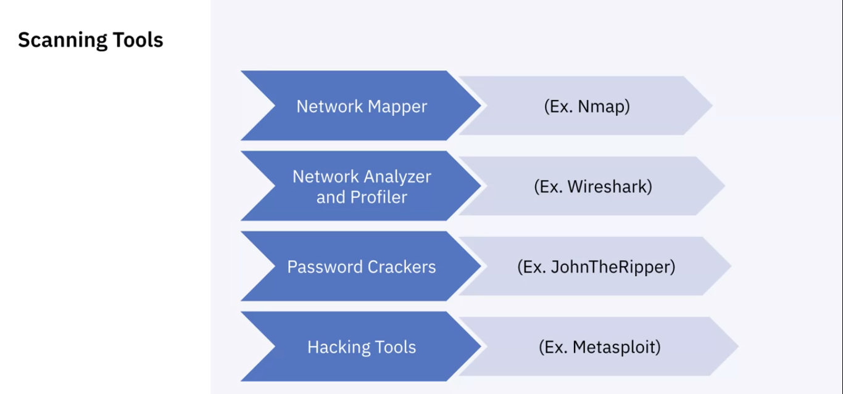

Slide 13


Hands on -Pentesting tools

Slide 14
Certifications resources
CISSP - (ISC)²
Ceh – EC Council
Oscp – OFFENSIVE SECURITY
Cisa - ISACA
GSEC - GIAC
Learning Ethical Hacking From Scratch Training Course | Udemy
IBM Cybersecurity Analyst Professional Certificate | Coursera
Free Cybersecurity Training and Career Development | Cybrary
ROADMAP- How do I get Started in Cyber Security? — My Perspective & Learning Path! | by Harsh Bothra | Medium
YOUTUBE – Hackersploit, ippses (CTF’S), The Cyber Mentor, John Hammond, David Bombal, Loi Liang Yang and Network Chunk

Slide 15
REFERENCES
(Used For This Session)
NIST Special Publication 800-115, Technical Guide to Information Security Testing and Assessment
Top 5 Cyber Security Jobs in India in 2022 (simplilearn.com)
What Is Penetration Testing | Definition Methods (contrastsecurity.com)
Transmission Control Protocol 3 Way Handshake - Snabay Networking
Vulnerability Assessment and Penetration Testing Services | EGS (eccouncil.org)

Slide 16
ARIGATo minasan✌️
- SVN Ramakanth
CyberSec@GDSC

